Slide 1

Azure IAAS Encryption and security Best Practices

Slide 2

About Nathan Taylor
Cloud Engineer for machineLOGIC
I’ve been Working in Denver IT market for 14 years
Certifications:
Microsoft Specialist: Implementing Microsoft Azure Infrastructure Solutions
Microsoft Certified Solutions Associate Office 365
AWS Certified Solutions Architect Associate Level
Twitter: @ntaylor0909

Slide 3
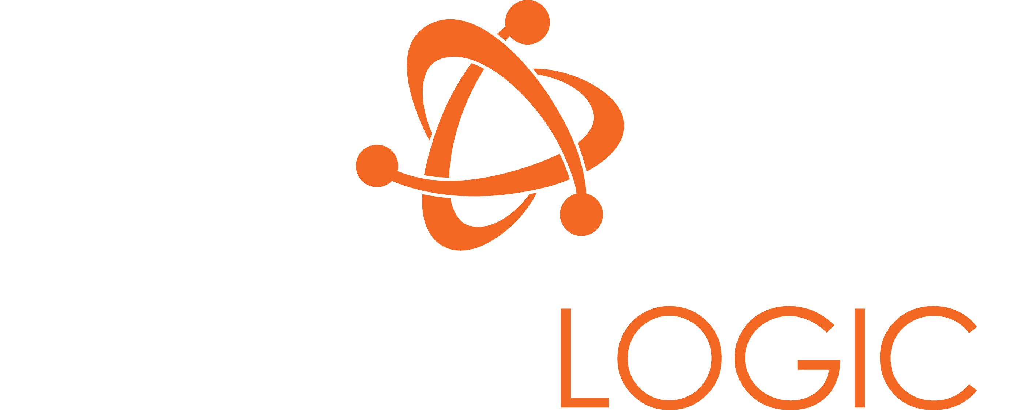
mPOWER YOUR BUSINESS

Slide 4
ABOUT MACHINELOGIC
Founded in 2001
Based in Denver, Colorado
Focused on Managed IT Services, Cloud Services, Talent Services
Develop a meaningful relationship with our clients
Apply our expertise to solve problems and create new opportunities
Microsoft Silver Partner

Slide 5
Managed Disk/Storage Account
Encryption
VM Disk Encryption
Other IAAS Security Best Practices
and Tools
What We will be covering

Slide 6
Referred to as Azure Storage Service Encryption
Enabled by default on Managed Disks
Has to be turned on for Storage Accounts
Encryption at Rest.
Storage Account and Managed Disk Encryption

Slide 7
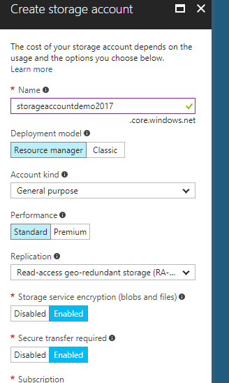
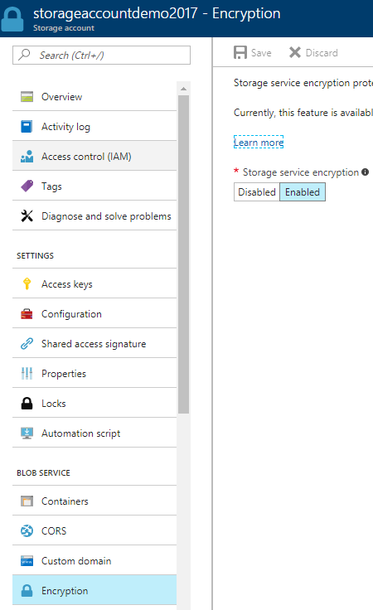
Examples:

Slide 8
Azure Disk Encryption
Disk Encryption using BitLocker
Keys are stored in Azure Key Vault
Can still be backed up
Azure Disk Encryption

Slide 9
2 Main Components:
BEK – Bitlocker Encryption Key
KEK – Key Encryption Key
A few other resources
Key Vault
Azure AD Application
Azure Disk Encryption

Slide 10
Deploy via PowerShell or ARM Template
Will likely require a reboot
Your data/VMs will be lost if you lose the BEK Keys
Register the Resource Provider
Azure Disk Encryption

Slide 11
Only available on Standard VMs
It’s available on Linux via DM-Crypt
Can Be applied to OS, Data, or All Disks
Azure Disk Encryption

Slide 12
PowerShell Time
https://blogs.technet.microsoft.com/privatecloud/2016/09/15/taking-backup-of-encrypted-azure-vms-with-ade-azure-disk-encryption-using-azure-backup-in-oms/
Azure Disk Encryption

Slide 13

Security Center
Azure Documentation
Azure blogs
Other Resources

Slide 14
Turn off RDP or limit it to specific Public IPs
Keep your machines patched
Run Anti-Malware
Use your Network Security Groups
Other Best Practices
Notes:
Components

Slide 15
Use Azure IAAS Backup or other backup solution
Use a Beachhead or Privileged Access Workstation
Turn on Multi-Factor Authentication for The Azure Portal
Constrained Administrative Access
Other Best Practices
Notes:
Components

Slide 16
THANK YOU!

